Slide 1
activities and prospects of the Radioactive Materials Management Laboratory at the NCSR “D”
Anastasia Savidou, Eleni Ntalla, A. Chanousis
Radioactive Materials Management Laboratory
Institute of Nuclear & Radiological Sciences & Technology, Energy & Safety,
National Centre for Scientific Research “Demokritos”
25th Annual Symposium of the Hellenic Nuclear Physics Society, 3-4 June, 2016, NCSR “Demokritos”, Athens

Slide 2
outline
nuclear and radwaste facilities in INRaSTES (ΙΠΡΕΤΕΑ στα ελληνικά)
the goal of radwaste management
national legislative frame
main points of national policy
main points of radwaste management
The activities of the RMML (ΕΔΡΥ στα ελληνικά)
prospects
25th Annual Symposium of the Hellenic Nuclear Physics Society, 3-4 June, 2016, NCSR “Demokritos”, Athens

Slide 3
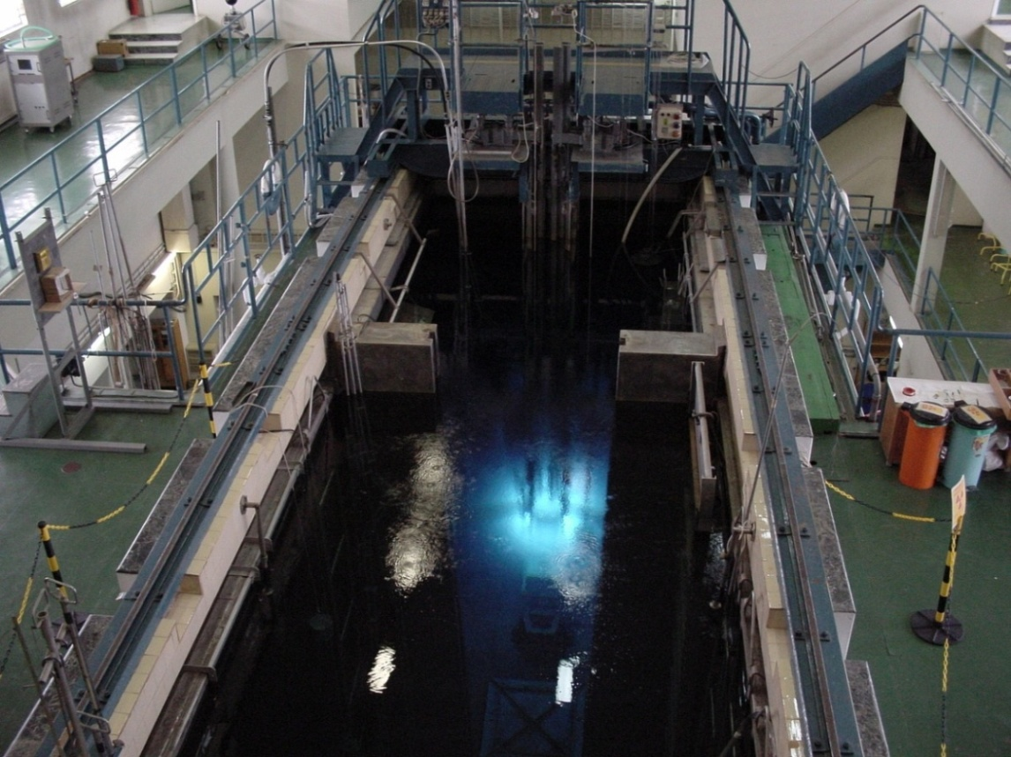
the Greek Research Reactor (GRR-1) of INRaSTES
- 5 MW
- open pool type
- MTR-type fuel elements
- Be reflectors
- material of PCS is Al, Steel
- first criticality 1961
- stop of operation in 2004
- extended shut down (6/6/2014)
GRR-1
25th Annual Symposium of the Hellenic Nuclear Physics Society, 3-4 June, 2016, NCSR “Demokritos”, Athens

Slide 4
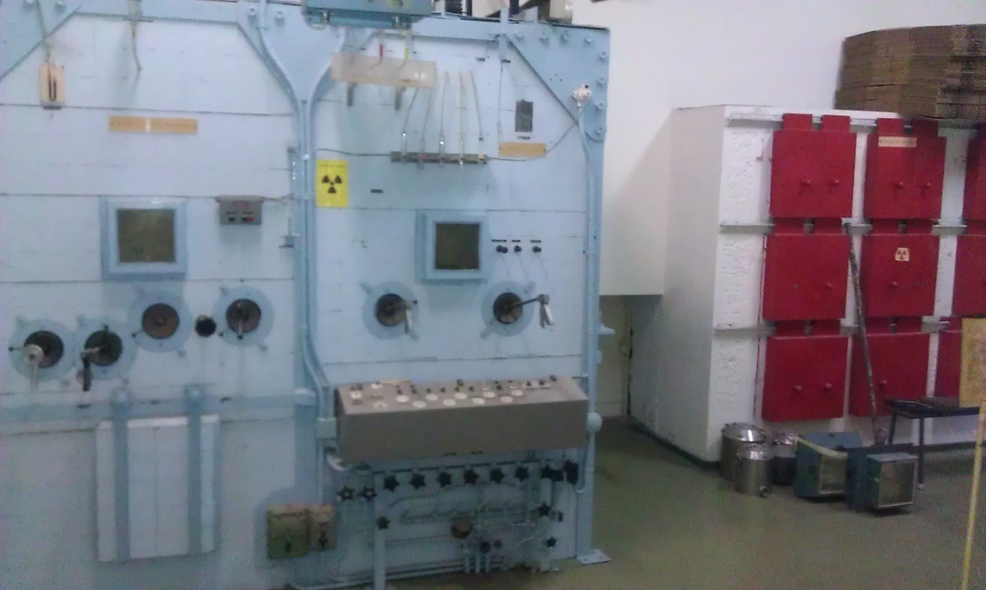
associated to the GRR-1 facilities of INRaSTES
hot cells at the radioisotope production laboratories (13) and many shielded cabinets
25th Annual Symposium of the Hellenic Nuclear Physics Society, 3-4 June, 2016, NCSR “Demokritos”, Athens

Slide 5
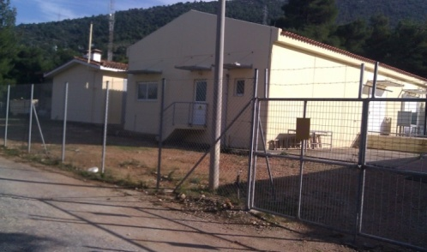
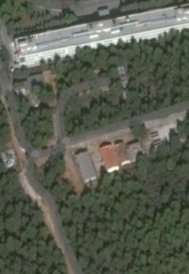
the RMML Facilities at INRaSTES
(1) the Radioactive Waste Interim Storage Facility
-for VLLW, LLW and radioactive sources
(2) three Storage facilities with historical waste
(3) the station for segregation and cementation of radioactive waste
- clearance of VSLW
- natural and radiological sorting/ clearance VLLW
- cementation equipment (for sludge and powder)
(4) liquid waste retention tanks (15) and an old liquid waste evaporator
25th Annual Symposium of the Hellenic Nuclear Physics Society, 3-4 June, 2016, NCSR “Demokritos”, Athens

Slide 6
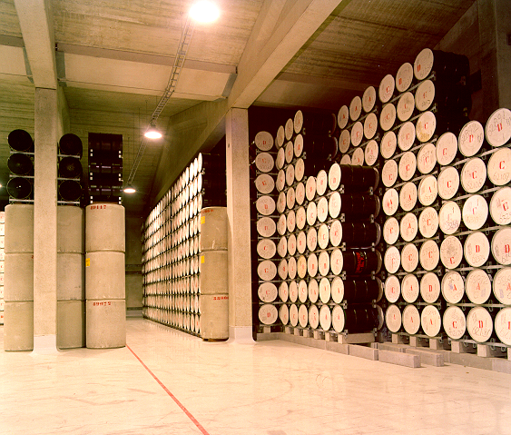
the goal of radwaste management (1)
containment of radionuclides by using a system of barriers, inside interim storages facilities (not more than 100 years)
Clearance
25th Annual Symposium of the Hellenic Nuclear Physics Society, 3-4 June, 2016, NCSR “Demokritos”, Athens

Slide 7
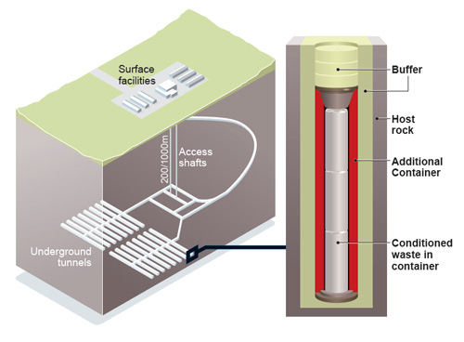
the goal of radwaste management (2)
containment of radionuclides by using a system of barriers, until decay inside specific under ground constructions called disposal facilities (for some hundreds to some hundreds of thousands of years)
25th Annual Symposium of the Hellenic Nuclear Physics Society, 3-4 June, 2016, NCSR “Demokritos”, Athens

Slide 8
national legislative frame for radwaste & spent fuel (1)
“Protection against ionizing radiation”, Government Gazette, Legislative Decree No. 181, Folio No:347, First Issue, November 20, 1974
“Radiation protection regulations”, Joint Ministerial Decision No. 1014 (FOR) 1994, Second Issue, Folio No. 216, March 6, 2001
“Control of high-activity sealed radioactive sources and orphan sources”, Government Gazette, Ministerial Decision No. 10828/(EFA)1897, Folio No. 859, Second Issue, July 10, 2006 (transposition of the Council Directive 2003/122/Euratom)
“Establishing a National framework for the nuclear safety of nuclear installations”, Presidential Decree No. 60, Folio No. 111, First Issue, May 3, 2012, (transposition of the Council Directive 2009/71/ Euratom of 25 June 2009)
“Establishing a Community framework for the responsible and safe management of spent fuel and radioactive waste”, Presidential Decree No. 122, Folio No. 177, First Issue, August 12, 2013, (transposition of the Council Directive 2011/70/ Euratom of 19 July 2011)
“Establishment of the National Policy for the management of spent fuel and radioactive waste”, Government Gazette, Joint Ministerial Decision No. 131207/I3, Folio No. 1858, First Issue, August 27, 2015
“NATIONAL PROGRAM for the management of spent fuel and radioactive waste”, Government Gazette, Ministerial Decision No. Π/112/214196, Folio No. 2941, First Issue, December 31, 2015
25th Annual Symposium of the Hellenic Nuclear Physics Society, 3-4 June, 2016, NCSR “Demokritos”, Athens

Slide 9
national policy – main points
until the establishment of the disposal facility the radwaste shall be stored in authorized interim storage facilities
disposal will be allowed only for radwaste produced in Greece
sources are returned to manufacturer or producer according to applicable agreement submitted to GAEC before importing
GRR-1 SF is returned to the manufacturer or supplier country, according to applicable agreements
25th Annual Symposium of the Hellenic Nuclear Physics Society, 3-4 June, 2016, NCSR “Demokritos”, Athens

Slide 10
radwaste management in Greece – main points
current practices: storage on site or in NCSR “D” interim storage, storage for decay and clearance, storage/ export or until future disposal
no specific clearance only the general clearance (RPR, RP122 part I)
registry for all radioactive waste - sources – material by GAEC
no official plan for radioactive waste disposal facility in the country.
appropriate disposal facility/ies types will be decided in the next years
integrated strategy for radioactive waste management will be determined in the next years
25th Annual Symposium of the Hellenic Nuclear Physics Society, 3-4 June, 2016, NCSR “Demokritos”, Athens

Slide 11
RMML (ΕΔΡΥ) activities
development of techniques for radiological characterization of radioactive waste and nuclear facilities as well as for verification of clearance
elaboration and performance of studies for radiological characterization of radioactive waste and facilities
planning and costing the decommissioning of nuclear infrastructures
elaboration of studies for upgrading of the radioactive waste management facilities in order the country to comply with the latest EU requirements
specialized services: withdrawal of spent/ disused radioactive sources and devices as well as the management of radioactive waste
25th Annual Symposium of the Hellenic Nuclear Physics Society, 3-4 June, 2016, NCSR “Demokritos”, Athens

Slide 12
the prospects
the radioactive waste management facilities of the NCSRD, to be designated as the centralized facilities of the country, in order the Centre to contribute crucially in protection of the public health
further development of expertise and skills in radioactive waste management and decommissioning of nuclear facilities and expansion of the provided services for keeping financial recourses within the country
25th Annual Symposium of the Hellenic Nuclear Physics Society, 3-4 June, 2016, NCSR “Demokritos”, Athens

Slide 13
Thank you for your attention
25th Annual Symposium of the Hellenic Nuclear Physics Society, 3-4 June, 2016, NCSR “Demokritos”, Athens

