Slide 1
25th HNPS, 3-4 June 2016
¹⁹⁷Au(n,xn) reactions
at TSL high energy neutron facility
at Uppsala
NATIONAL TECHNICAL
UNIVERSITY OF ATHENS
UPPSALA
UNIVERSITET
Antigoni Kalamara

Slide 2
Motivation
Studies of excitation functions of nuclear reactions are of considerable importance for testing nuclear models as well as for practical applications.
Neutron induced reactions on ¹⁹⁷Au are used as reference reactions thus it is very important to have complete and reliable data.
The residual nuclei from the ¹⁹⁷Au(n,xn) channels have reasonable half-lives and can be measured using the activation method, providing a complete set of exit channels for testing nuclear models.
Above 20 MeV, existing data for the (n,3n) and (n,4n) reactions were obtained with very poor statistics and present many discrepancies among them, while for the (n,5n) and (n,6n) channels, only few data points exist.
Above 20 MeV a truly monoenergetic neutron beam is not feasible in a strict sense. However, for certain nuclear reactions there is a strong dominance of neutrons in a narrow energy range and such neutron sources are often called “quasi-monoenergetic”.
Antigoni Kalamara, NTUA 25th ΗΝPS, June 2016

Slide 3
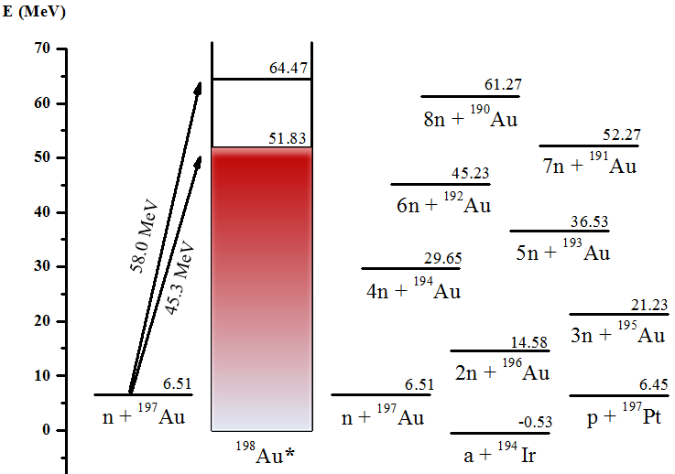
The interaction n + ¹⁹⁷Au
¹⁹⁷Au (n,2n) ¹⁹⁶Au
Τ_{1/2} = 6.2 h
¹⁹⁷Au (n,3n) ¹⁹⁵Au
Τ_{1/2} = 186.1 d
¹⁹⁷Au (n,4n) ¹⁹⁴Au
Τ_{1/2} = 38.0 h
¹⁹⁷Au (n,5n) ¹⁹³Au
Τ_{1/2} = 17.7 h
¹⁹⁷Au (n,6n) ¹⁹²Au
Τ_{1/2} = 3.2 h
¹⁹⁷Au (n,7n) ¹⁹¹Au
Τ_{1/2} = 3.2 h
Antigoni Kalamara, NTUA 25th ΗΝPS, June 2016

Slide 4
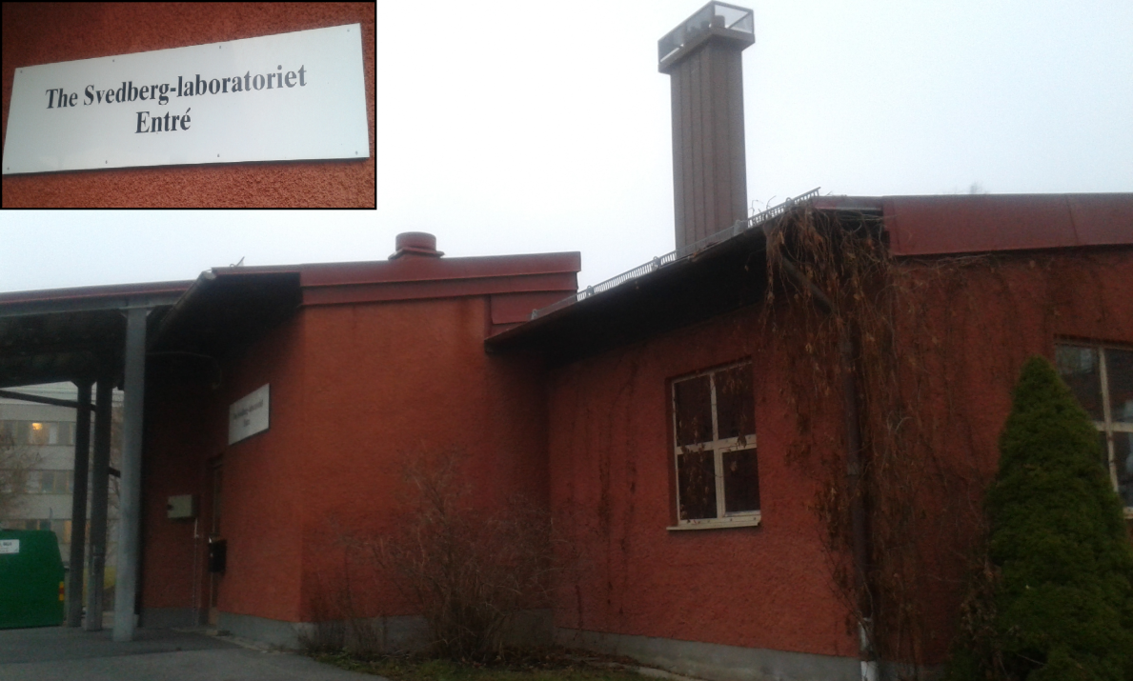
The interaction n + ¹⁹⁷Au
¹⁹⁷Au (n,2n) ¹⁹⁶Au
Τ_{1/2} = 6.2 h
¹⁹⁷Au (n,3n) ¹⁹⁵Au
Τ_{1/2} = 186.1 d
¹⁹⁷Au (n,4n) ¹⁹⁴Au
Τ_{1/2} = 38.0 h
¹⁹⁷Au (n,5n) ¹⁹³Au
Τ_{1/2} = 17.7 h
¹⁹⁷Au (n,6n) ¹⁹²Au
Τ_{1/2} = 3.2 h
¹⁹⁷Au (n,7n) ¹⁹¹Au
Τ_{1/2} = 3.2 h
The most popular reaction for the production of a quasi-monoenergetic neutron beam above 20 MeV is ⁷Li(p,n)⁷Be.
TSL → The Svedberg Laboratory
(Uppsala)
Antigoni Kalamara, NTUA 25th ΗΝPS, June 2016

Slide 5
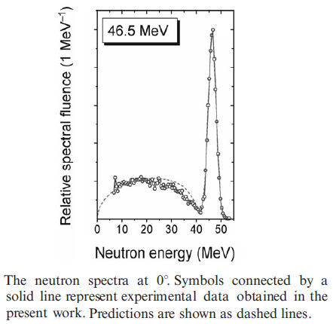
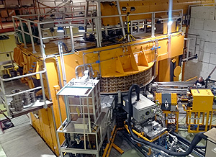
The interaction n + ¹⁹⁷Au
In order to determine the cross section of the (n,xn) reactions, the neutron energy distribution is needed, thus the characterization of the beam is of major importance.
¹⁹⁷Au (n,2n) ¹⁹⁶Au
Τ_{1/2} = 6.2 h
¹⁹⁷Au (n,3n) ¹⁹⁵Au
Τ_{1/2} = 186.1 d
¹⁹⁷Au (n,4n) ¹⁹⁴Au
Τ_{1/2} = 38.0 h
¹⁹⁷Au (n,5n) ¹⁹³Au
Τ_{1/2} = 17.7 h
¹⁹⁷Au (n,6n) ¹⁹²Au
Τ_{1/2} = 3.2 h
¹⁹⁷Au (n,7n) ¹⁹¹Au
Τ_{1/2} = 3.2 h
The most popular reaction for the production of a quasi-monoenergetic neutron beam above 20 MeV is ⁷Li(p,n)⁷Be.
A Gustaf Werner cyclotron is used for neutron production through:
beam $H_{2}^{+}$ ions with energy of ~13 MeV A⁻¹
proton beam with energy variable in the 25-180 MeV range.
The energy of the produced peak neutrons is controllable in the 11-175 MeV range.
THE TSL NEUTRON BEAM FACILITY,
Radiation Protection Dosimetry (2007),
Vol. 126, No. 1–4, pp. 18–22, doi:10.1093
Antigoni Kalamara, NTUA 25th ΗΝPS, June 2016

Slide 6
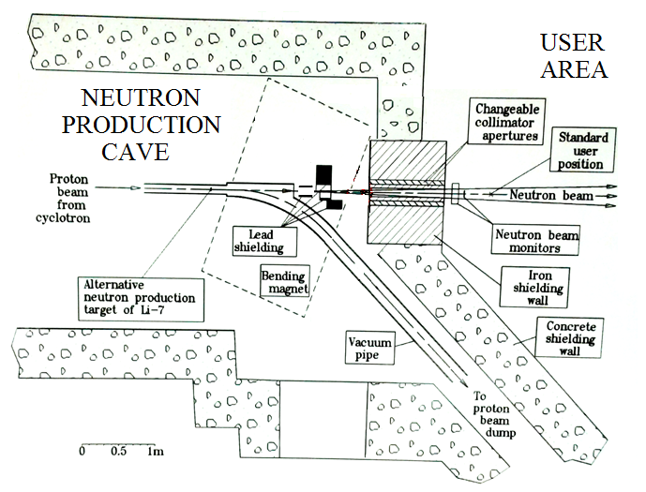
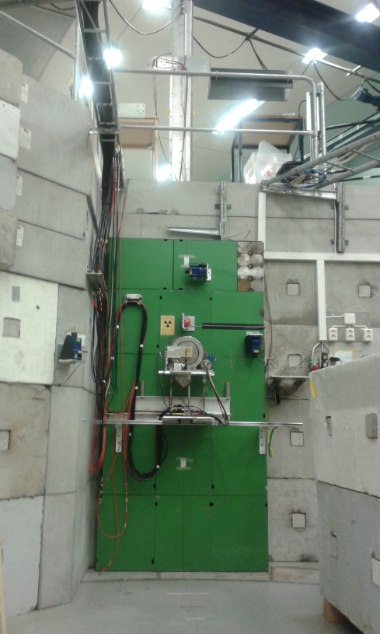
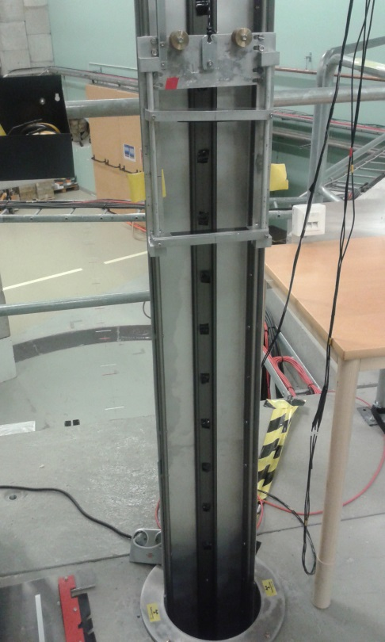
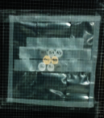
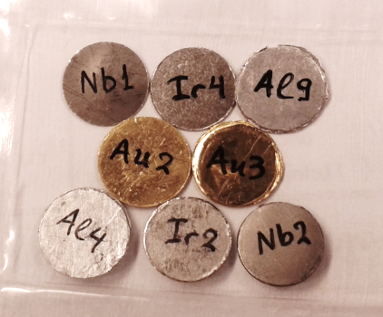
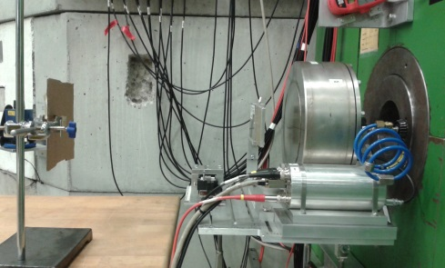
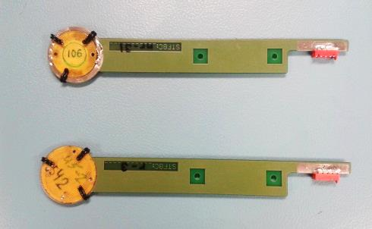
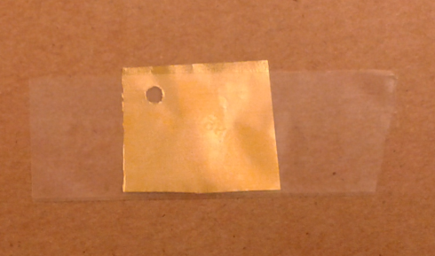
Experimental setup at TSL
CUP → Close User Position (~2 m)
Overview of the irradiation lab.
SUP → Standard User Position ($\text{\sim }$4 m)
CUP
p+⁷Li
n
CUP
p
SUP
CUP
SUP
ToF measurements
Thin Film Breakdown Counters
Antigoni Kalamara, NTUA 25th ΗΝPS, June 2016

Slide 7
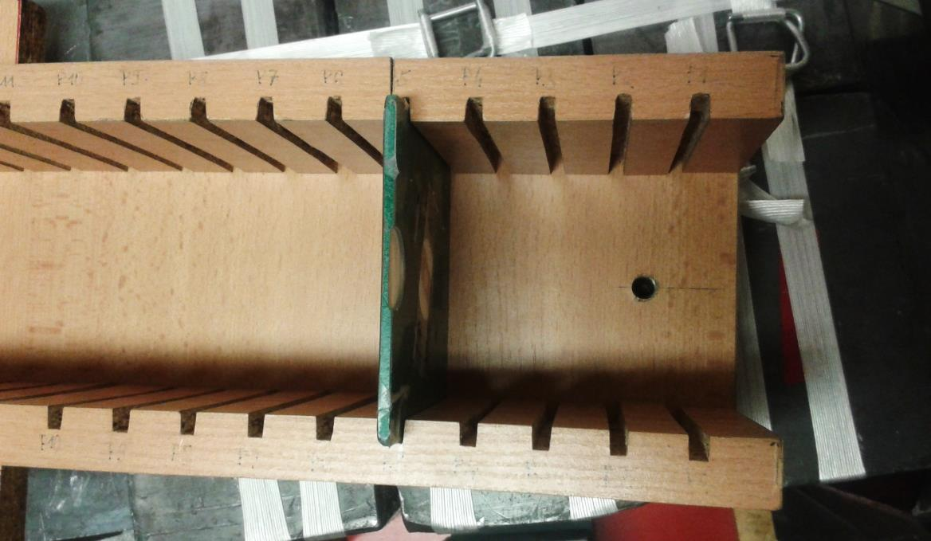
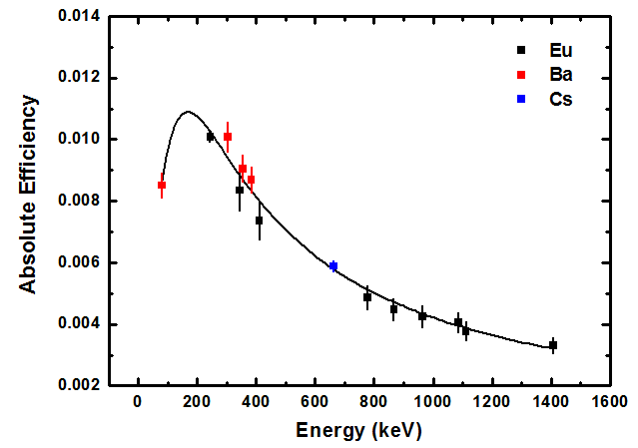
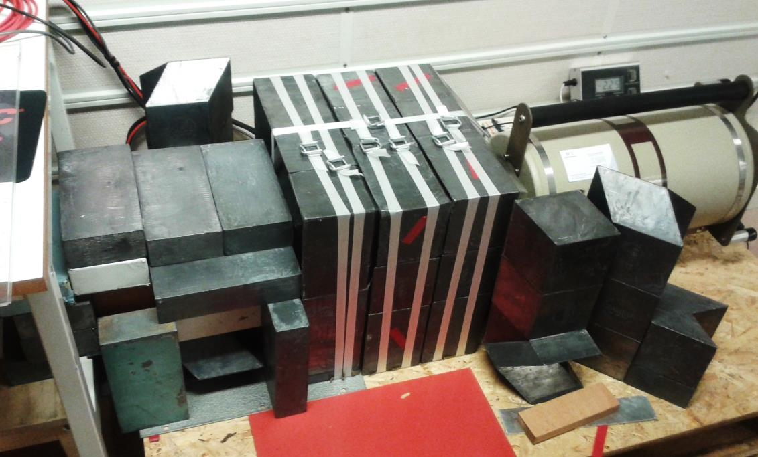
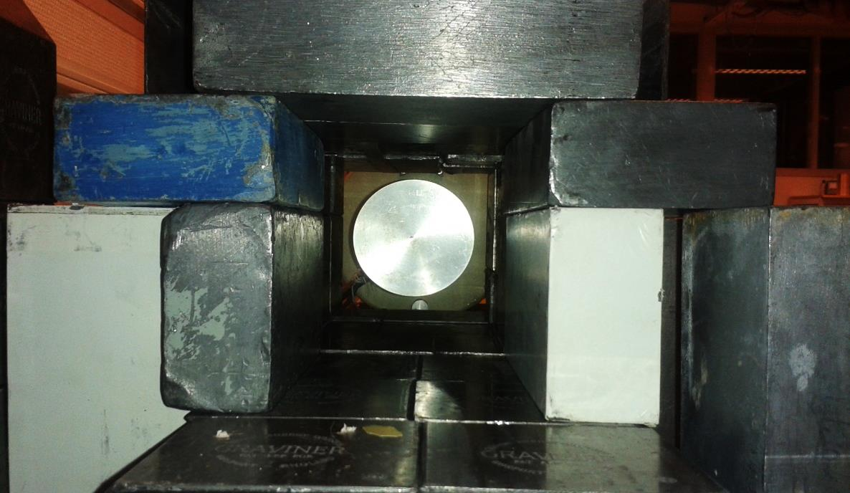
Activation Measurements
Following the irradiations, the induced activity on the samples was measured with a high-purity germanium (HPGe) detector of 80% relative efficiency, properly shielded with lead blocks in order to reduce the contribution of the natural radioactivity.
10 cm
The samples were placed at a distance of 10 cm from the detector window so that the corrections for coincidence summing become negligible.
The detectors were calibrated using ¹⁵²Eu, ¹³³Ba and ¹³⁷Cs sources.
Antigoni Kalamara, NTUA 25th ΗΝPS, June 2016

Slide 8
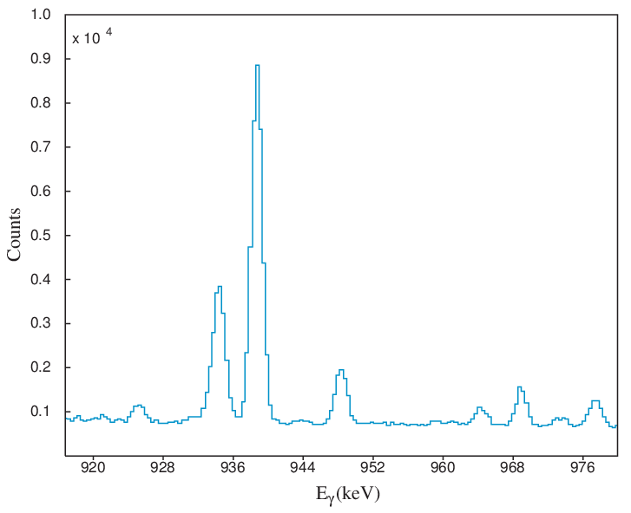
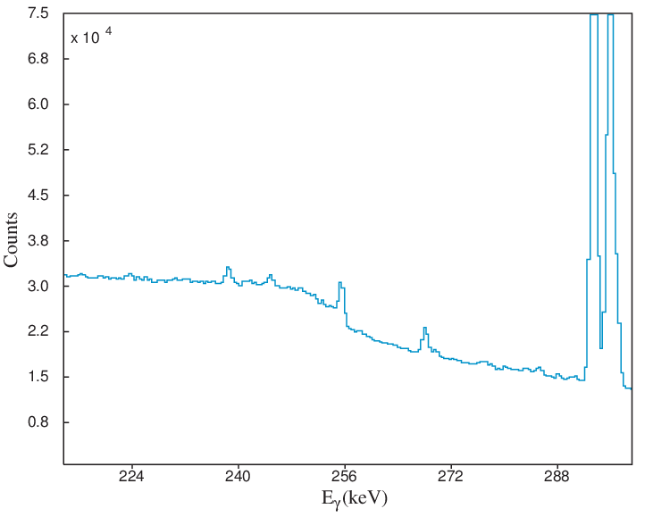
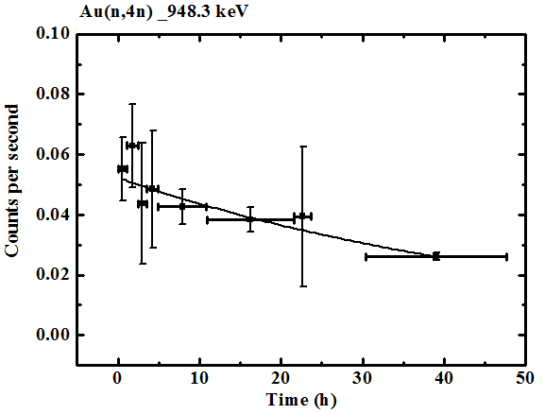
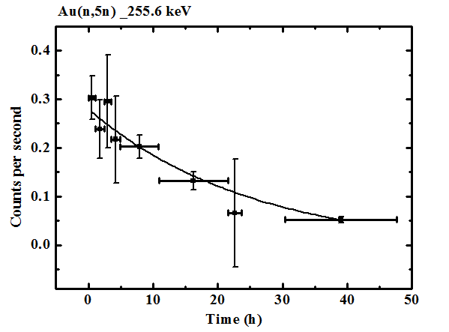
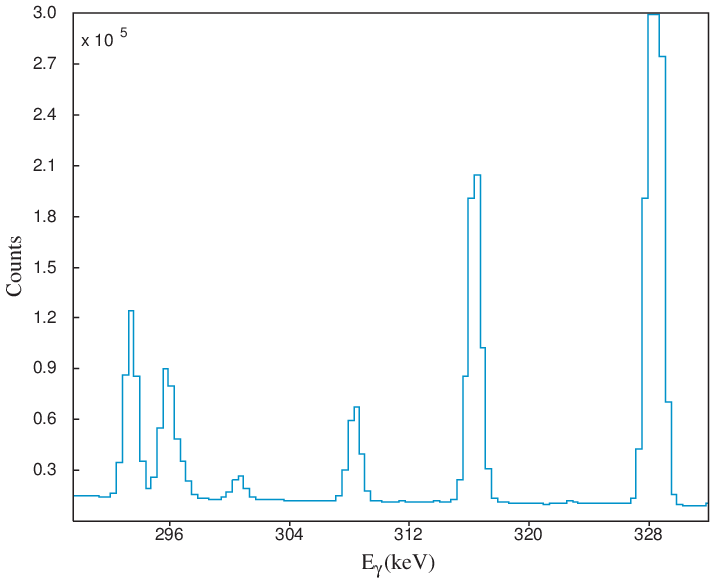
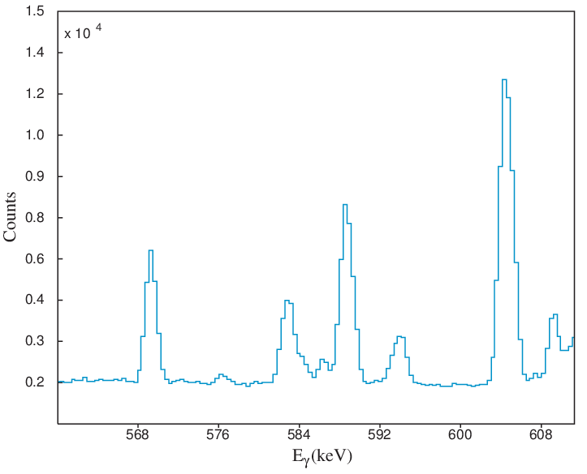
Spectra Investigation
¹⁹⁷Au(n,4n)¹⁹⁴Au
¹⁹⁷Au(n,5n)¹⁹³Au
255.6 keV
948.3 keV
¹⁹⁷Au(n,6n)¹⁹²Au
¹⁹⁷Au(n,7n)¹⁹¹Au
T_{1/2} = 38 h
T_{1/2} = 18 h
316.5 keV
586.5 keV
Antigoni Kalamara, NTUA 25th ΗΝPS, June 2016

Slide 9
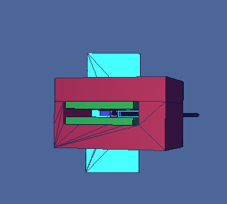
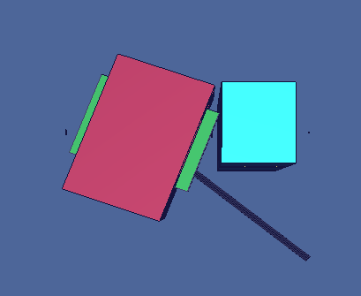
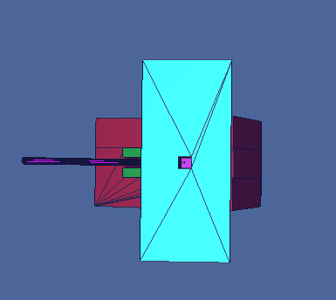
MCNP5 Simulations
In order to study the neutron beam profile, MCNP5 simulations were performed taking into account the experimental set up in high detail.
3D-View
CUP
SUP
Au foil at SUP position
Foils at CUP position
Proton beam dump tube
The whole magnet
Fe wall
Li target
Antigoni Kalamara, NTUA 25th ΗΝPS, June 2016

Slide 10
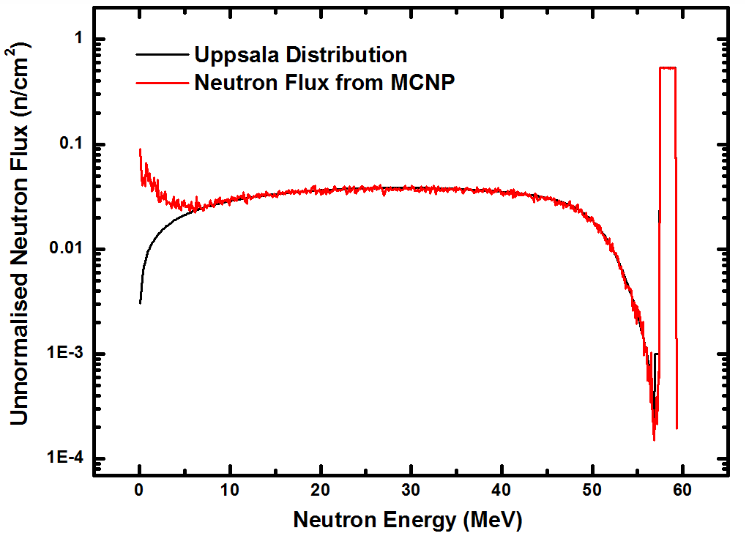
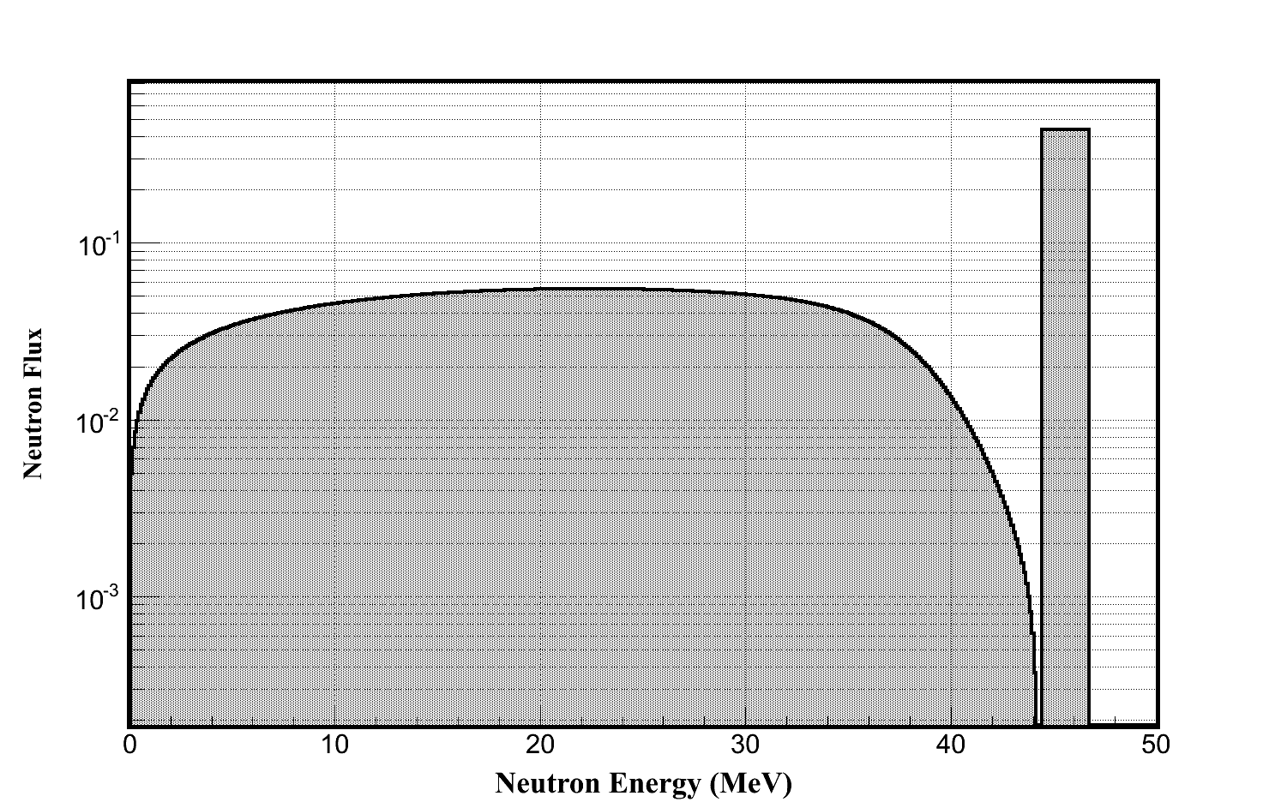
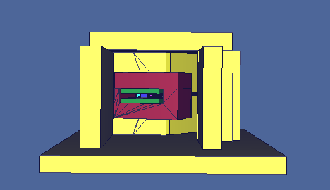
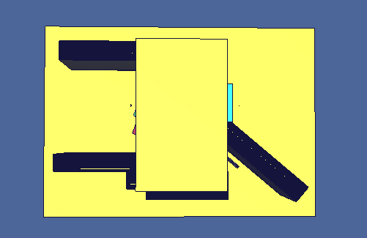
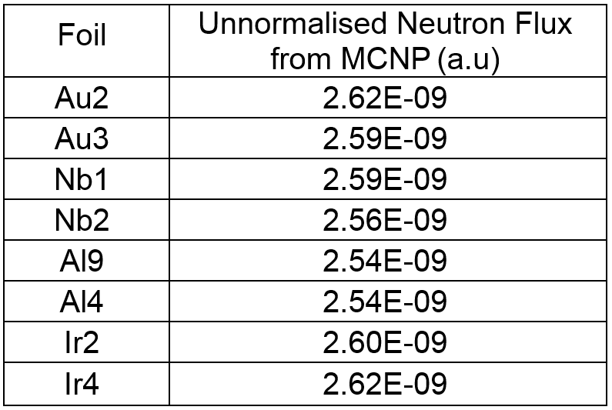
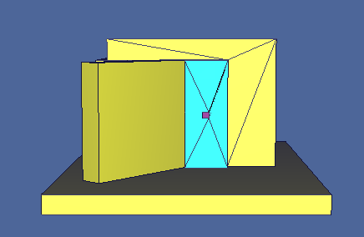
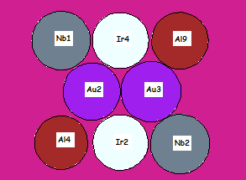
MCNP5 Simulations
MCNP5 Results
In order to study the neutron beam profile, MCNP5 simulations were performed taking into account the experimental set up in high detail.
The surrounding materials contribute to a low energy neutron tail which is not essential when studying threshold reactions.
CUP
Lateral homogeneity within 3%.
Neutron energy distribution
Check:
Lateral homogeneity of neutron flux on the target set up.
The effects of surrounding materials to the neutron flux.
Concrete floor, ceiling and walls
Antigoni Kalamara, NTUA 25th ΗΝPS, June 2016

Slide 11
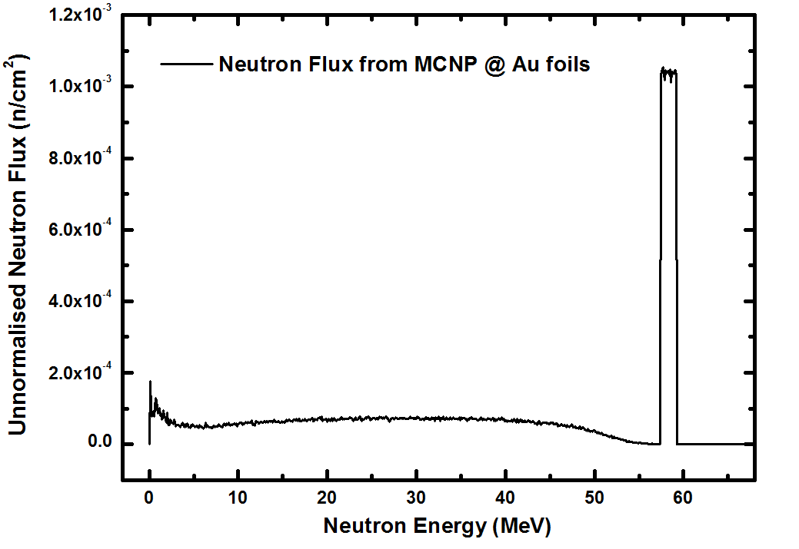
$${RR}_{mcnp}= \sum_{i=0 MeV}^{70 MeV}{σ_{i}\left(E\right)∙{Φ_{mcnp}}_{i}(Ε)}$$
Estimation of the absolute neutron flux
The reaction rate can be determined theoretically according to this expres-sion:
Ε_{i}
$${RR}_{mcnp}= \sum_{i=0 MeV}^{70 MeV}{\left.σ_{i}\left(E_{i}\right)∙{Φ_{mcnp}}_{i}(E_{i}\right)}$$
The cross section of the reaction is determined by interpolating the TENDL data.
The neutron flux in the target is taken from simulation.
Moreover, the reaction rate can be defined experimentally with this expression:
Decay constant of the residual nucleus.
$${RR}_{experimental} (\sec^{−1})= \frac{λ ∙ N_{p}}{N_{t}}$$
Number of the produced nuclei.
Number of the target nuclei.
Antigoni Kalamara, NTUA 25th ΗΝPS, June 2016

Slide 12
$$r (\sec^{−1})= \frac{{RR}_{ experimental}}{{RR}_{mcnp}}$$
Estimation of the absolute neutron flux
After finding the normalization factor r:
$${RR}_{mcnp}= \sum_{i=0 MeV}^{70 MeV}{\left.σ_{i}\left(E_{i}\right)∙{Φ_{mcnp}}_{i}(E_{i}\right)}$$
$$r (\sec^{−1})= \frac{{RR}_{ experimental}}{{RR}_{mcnp}}$$
$${RR}_{experimental} (\sec^{−1})= \frac{λ ∙ N_{p}}{N_{t}}$$
The total absolute neutron flux can be estimated through the expression:
$$Total Neutron Flux \left(\frac{n}{{cm}^{2 } sec}\right)= \sum_{i=0 MeV}^{70 MeV}{\left.{{r ∙ Φ}_{mcnp}}_{i}(E_{i}\right)}$$
8.4 x 10⁴ n/cm² s
Antigoni Kalamara, NTUA 25th ΗΝPS, June 2016

Slide 13
Future work
To normalize the absolute value of the neutron spectrum and testify the results with well known reference reactions:
²⁷Al(n,a)
⁹³Nb(n,2n)
²³⁸U(n,f)
To deduce the cross section of (n,4n), (n,5n) (n,6n) and (n,7n) reactions.
Theoretical calculations using the EMPIRE code.
The most accurate information about the neutron flux distribution will be provided from the ToF spectrum.
Antigoni Kalamara, NTUA 25th ΗΝPS, June 2016

Slide 14
Future work
25th HNPS, 3-4 June 2016
To normalize the absolute value of the neutron spectrum and testify the results with well known reference reactions:
²⁷Al(n,a)
⁹³Nb(n,2n)
²³⁸U(n,f)
To deduce the cross section of (n,4n), (n,5n) (n,6n) and (n,7n) reactions.
Theoretical calculations using the EMPIRE code.
The most accurate information about the neutron flux distribution will be provided from the ToF spectrum.
A. Kalamara, R. Vlastou, M. Kokkoris, A. Stamatopoulos,
A. Mattera, M. Lantz, E. Passoth, A. Prokoviev and V. Rakopoulos
Antigoni Kalamara, NTUA 25th ΗΝPS, June 2016

Slide 15
Future work
25th HNPS, 3-4 June 2016
To normalize the absolute value of the neutron spectrum and testify the results with well known reference reactions:
²⁷Al(n,a)
⁹³Nb(n,2n)
²³⁸U(n,f)
To deduce the cross section of (n,4n), (n,5n) (n,6n) and (n,7n) reactions.
Theoretical calculations using the EMPIRE code.
The most accurate information about the neutron flux distribution will be provided from the ToF spectrum.
A. Kalamara, R. Vlastou, M. Kokkoris, A. Stamatopoulos,
A. Mattera, M. Lantz, E. Passoth, A. Prokoviev and V. Rakopoulos

Slide 16
Future work
25th HNPS, 3-4 June 2016
To normalize the absolute value of the neutron spectrum and testify the results with well known reference reactions:
²⁷Al(n,a)
⁹³Nb(n,2n)
²³⁸U(n,f)
To deduce the cross section of (n,4n), (n,5n) (n,6n) and (n,7n) reactions.
Theoretical calculations using the EMPIRE code.
The most accurate information about the neutron flux distribution will be provided from the ToF spectrum.
A. Kalamara, R. Vlastou, M. Kokkoris, A. Stamatopoulos,
A. Mattera, M. Lantz, E. Passoth, A. Prokoviev and V. Rakopoulos

Slide 17
Stop signal!
j
TFBC’s
TFBC → Thin Film Breakdown Counter
Fissionable Target
²³⁸U
²³⁸U(n,f) reaction
Fission product
HV
Breakdown discharge
Two electrodes separated
by a dielectric layer
The electric field between the two electrodes is sufficient to induce a breakdown once a fission product creates free charges in the dielectric layer. The current generated produces a detectable signal and at the same time evaporates a portion of the electrode, interrupting the short-circuit.
Antigoni Kalamara, NTUA 25th ΗΝPS, June 2016

Slide 18
Different neutron beam apertures
j
Antigoni Kalamara, NTUA 25th ΗΝPS, June 2016

