Slide 1

Temporal Variations of ⁷Be and its AMAD over “Demokritos” GAW station
National Centre of Scientific Research “Demokritos”
National Technical University of Athens
Nuclear Engineering Department
E. Dalaka^{1,2,*}, M.J. Anagnostakis² and K. Eleftheriadis¹
¹Institute of Nuclear & Radiological Sciences & Technology, Energy & Safety, Environmental Radioactivity Laboratory, National Centre of Scientific Research “Demokritos”, 15310 Ag. Paraskevi, Attiki, Greece
² Nuclear Engineering Laboratory, National Technical University of Athens, 15780, Athens, Greece
15780, Athens, Greece
*edalaka@ipta.demokritos.gr
25th Annual Symposium of the Hellenic Nuclear Physics Society
June 3-4, 2016, NCSR “Demokritos”, Athens, Greece

Slide 2
⁷Be
natural occurring radioactive nuclide with half life t_{1/2}=53.3d
cosmogenic origin; formed in the upper troposphere (production rate 33% of the total production in the atmosphere) and lower stratosphere by spallation reactions of light atmospheric nuclei of nitrogen and oxygen with cosmic rays. The ⁷Be produced in the stratosphere, comes into the troposphere by exchange processes due to variations in atmospheric conditions associated with seasonal changes.
⁷Be production has negligible dependence on season and longitude, and varies on 11-year solar cycle
The energy threshold for its production is at 40 MeV
After production ⁷Be attaches to aerosol particles, which finally deposit on the ground and its residence time in atmospheric aerosol, depends on latitude and longitude of the region that it is being produced.

Slide 3
⁷Be
So by studying the fluctuation of ⁷Be activity concentration in the atmosphere, we can estimate ⁷Be residence time in the atmosphere, thus aerosols residence time. This is very important especially in atmospheric pollution studies.

Slide 4
⁷Be
⁷Be is a very reliable tracer when used to study phenomena
On annual basis:
air mass origin
vertical convection
(by its activity concentration levels)
aerosol particles’ transport
radiation protection, atmospheric pollution
11-year solar cycle
In this work, ⁷Be activity time series and parameters from the calculated ⁷Be size distributions were studied with respect to atmospheric conditions during the past 5 years.

Slide 5
AMAD
Activity Median Aerodynamic Diameter
The AMAD is the value of aerodynamic diameter for which 50% of the airborne activity in a given aerosol is associated with particles smaller than the AMAD and 50% of the activity is associated with particles larger than the AMAD.
The AMAD is used in internal dosimetry as a means of simplifying
the true size distribution of a given aerosol with a single value.
Is important for determining the fractional deposition of inhaled particles in the respiratory tract and the resulting doses

Slide 6
Methods
Since March, 2011 an atmospheric sampling program by means of High Volume samplers has been established at “Demokritos” urban background station (GAW-DEM, 2007).

Slide 7
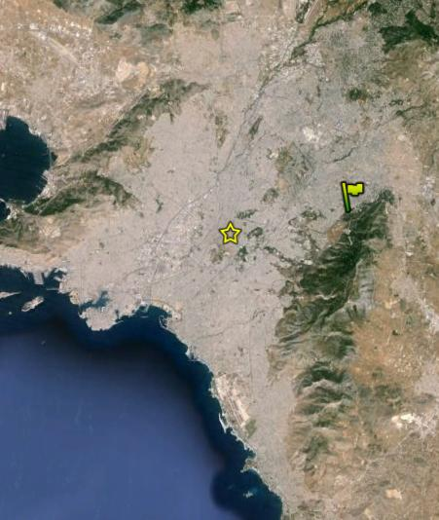
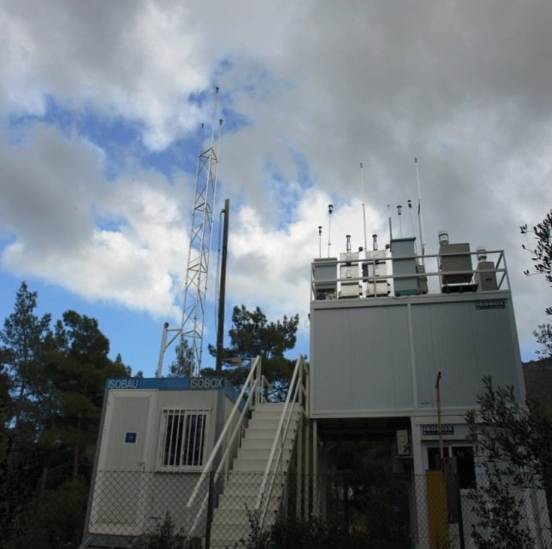
Methods
Station’s Location:
  ERL field site,
  NCSR “Demokritos” campus
  North East corner of the Greater Athens Metropolitan Area
  altitude of 270 m.a.s.l.
Demokritos station
Athens city centre
Location of station in Athens metropolitan area.

Slide 8
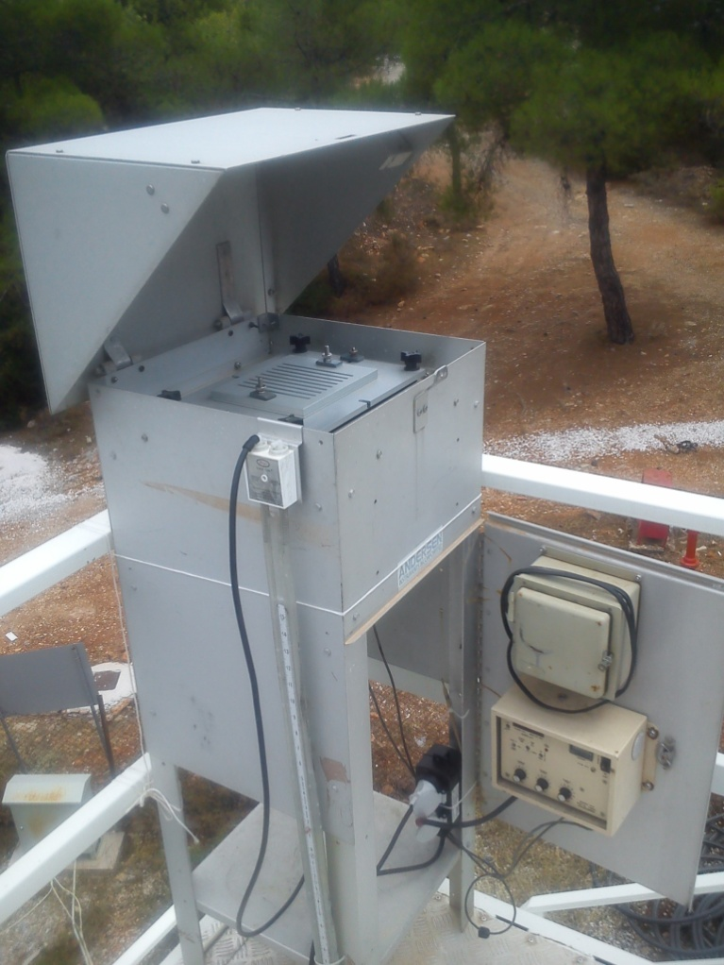
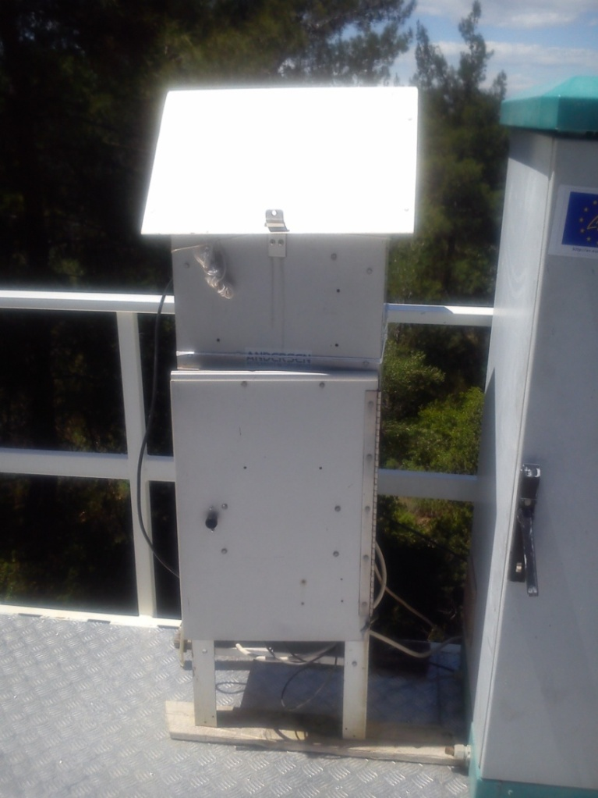
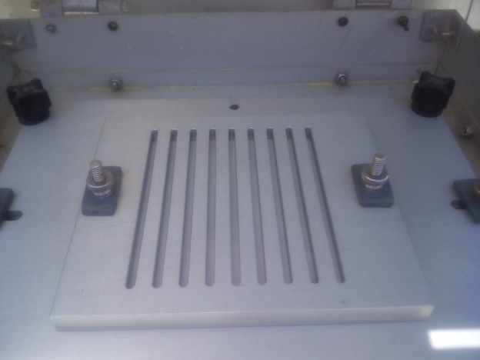
Methods
Sampling system:
  Six-stage high volume cascade impactor (once a month)
  nominal 50% cutoff sizes: 10.1, 4.2, 2.1, 1.4, 0.73, 0.41, 0.05 μm)
  High volume Sampler (once a week)
Sampling period:
  7days
Sampling Vol:
  ~ 4600 m³
Andersen High volume cascade impactor

Slide 9
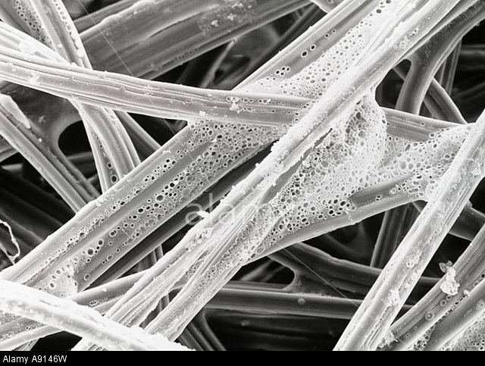
Methods
  Filters used:
  Cellulose Filters (low Bkg)
Filter preparation:
  cut to an appropriate geometry before sampling
  coated with a greasy organic material (in order to reduce bouncing impact in impactor’s stages)
Scanning Electron Microscope close-up of filter paper fibers magnified approximately 800X - A9146W

Slide 10
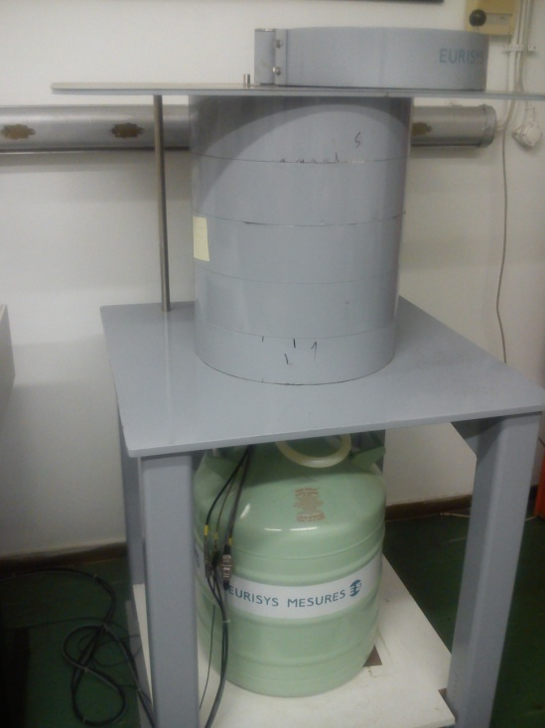
Methods
Photo peak used:
  477.59keV
Detector used:
  coaxial HP 30% Germanium detector, with energy resolution of 1.93keV for ⁶⁰Co (1332keV) and a 8k multichannel analyzer, with energy resolution 0.25 keV/channel.
Spectra collection and analysis:
  software Interwinner 4.1.
HP30% Germanium Detector

Slide 11
Results and discussion

Slide 12
⁷Be seasonal trend

Slide 13
⁷Be temporal variation

Slide 14
⁷Be size distribution

Slide 15
⁷Be AMAD seasonal trend

Slide 16
⁷Be AMAD Vs weather variants

Slide 17
⁷Be AMAD Vs weather variants

Slide 18
Conclusions
⁷Be concentrations have strong seasonal variability, with maxima during summer months and minima during winter months.
⁷Be concentrations have negative correlation with relative humidity
⁷Be concentrations have negative correlation with the amount of rainfall
⁷Be concentrations have positive correlation with temperature
⁷Be size distribution is affected by all these different atmospheric processes

Slide 19
Conclusions
⁷Be AMAD values are lower during summer months due to shorter residence time (fresh intrusions from the atmosphere)
⁷Be AMAD have generally lower values corresponding to higher P_{atm}, wind speed and T_{atm}, due to penetration of currents from upper atmospheric layers enriched with ⁷Be.
⁷Be AMAD values have positive correlation with RH and rainfall due to increase of particle size (humidity absorption) and increase of dry deposition velocity and increased wet scavenging rates

Slide 20
Conclusions
⁷Be, as well as its’ AMAD can be used as a tracer, thus providing with information regarding various atmospheric processes

Slide 21

Thank you
Integrated Design for Environmental and Energy Applications (IDEEA), GSRT KRIPIS

