Slide 1
Periodicity analysis of long period gamma radiation measurements in Thessaloniki , Greece.
Alexandros CLOUVAS ,Fokion LEONTARIS , Stelios XANTHOS* ,Antonis Maltezos**,Costas Potiriadis**
Nuclear Technology Laboratory
Aristotle University of Thessaloniki
* Alexander Technological Education Institute
** Greek Atomic Energy Commission

Slide 2
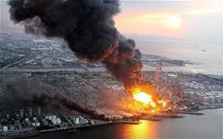
…..
The early warning stations, scattered all over Europe, is the best way against any radiological incident that may occur. The usefulness of the data they provide is not constrained to an early warning, but opens a wide range of data analysis. The amount of information gathered is enormous and more specific for our laboratory, the Nuclear Technology laboratory of Aristotle University of Thessaloniki, the database extends to 27 years (about 20000 measurements). The way of making the stations more secure and precise for any future incident is to understand and analyze the past, and that is exactly the purpose of the present work.

Slide 3
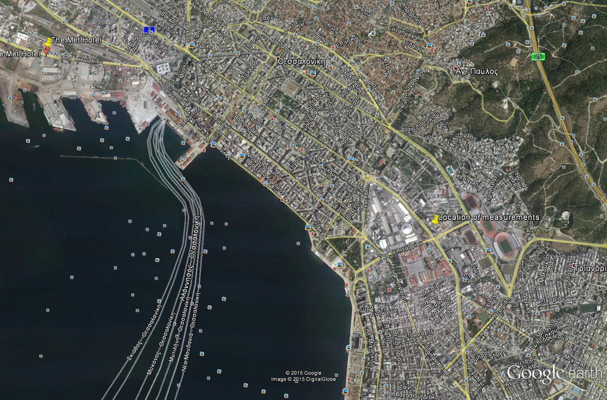

Slide 4
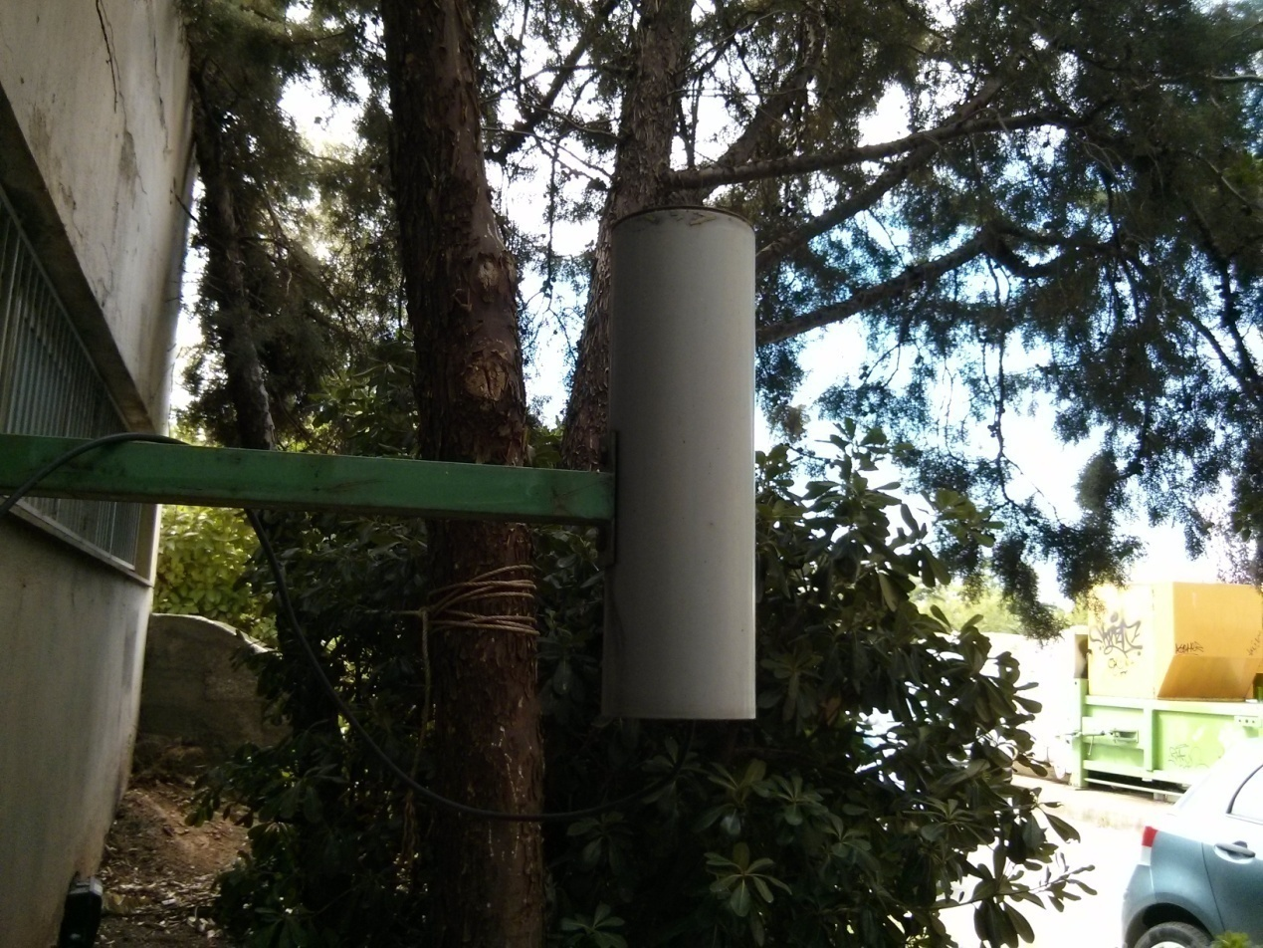
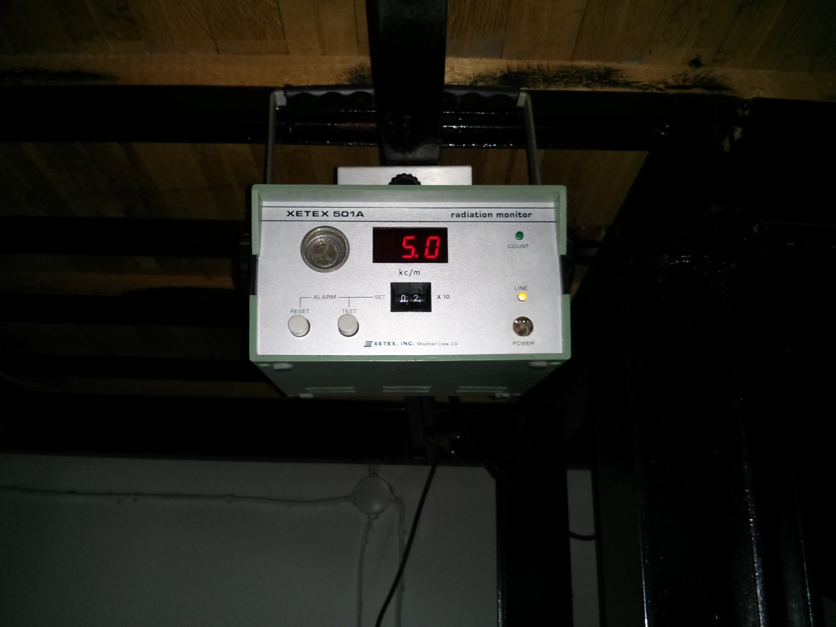
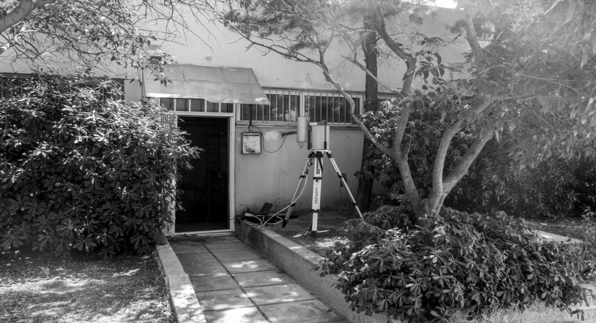
1988-2015
Measurements were performed once per day for 27 years.

Slide 5
Mean monthly values of gamma radiation measurements
The gamma dose rate decrease with an effective Half-life (t_{½}) of about 30 years
The gamma dose rate is the sum of the gamma dose rates due to 1) Uranium series 2) Thorium series 3) K-40 4) Cs-137 (due to the Chernobyl accident).
Taking into account that the decay Half-life (t_{½}) of Cs-137 is 30 years the effective Half-life (t_{½}) of the (total) gamma dose rate should be greater than 30 years (gamma dose rates due to Uranium series ,Thorium series and K-40 are in principle quite constant)

Slide 6
Measurements with HPGe detectors
The Xetex 501 A monitoring system cannot distinguish between the different contributions (Uranium series , Thorium series , K-40 ,Cs-137)
650 measurements were also performed during 1995-1998 , 2013 and 2014-015 with three HPGe detectors .

Slide 8
Cs-137
Effective half life 14.1 years
Absorbed gamma dose rate in air rate decrease with time due to natural decay (30 years half life) of Cs-137 and also due to the “removal “ of Cs-137 from the field of view of the detector .
1/T_{eff} = 1/T_{decay} + 1/T_{removal}

Slide 9
Signal processing…
The signal we are analyzing (time dependence of the total absorbed gamma dose rate D(t) in air) has some valuable components. From mathematical point of view the trend T(t) of the signal, is described by equation Parameter A is related to the absorbed gamma dose rates due to natural emitters (Uranium series, Thorium series, ⁴⁰K), which are quite constant and parameter B is related to absorbed gamma dose rate in air due to ¹³⁷Cs from the Chernobyl accident.
Detrended dose rate data

Slide 10
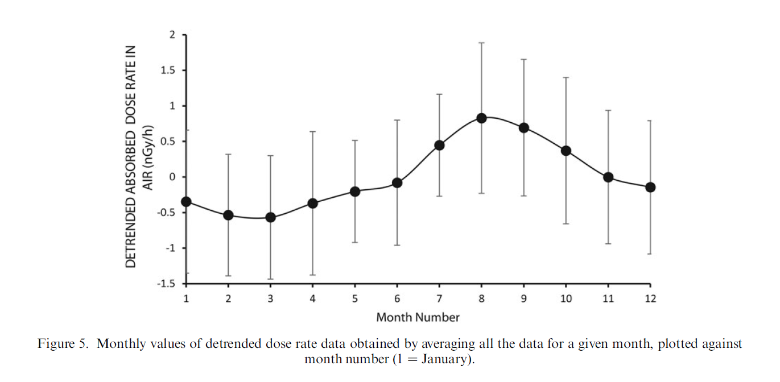

Slide 11
The rain effect on the gamma radiation above soil
Increase of gamma radiation due to radon progeny deposition
Decrease of gamma radiation due to increase humidity of soil
Unscattered gamma radiation due to ²¹⁴Pb after heavy rainfall with the appropriate fitting normalized to the average value of the previous two months. (T_{1/2}=28.1 minutes)

Slide 12
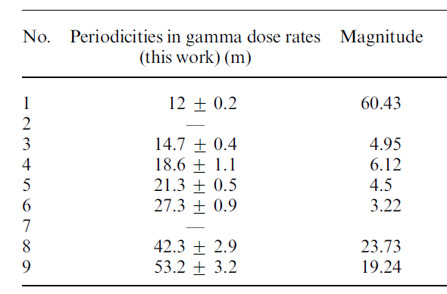
Fourier Transform
Periodogram of the data (Detrended gamma dose rate). There are three main discernible periodicities: 12±0.2 months, 42.3±2.9 months and 53.2±3.2 months.

Slide 13
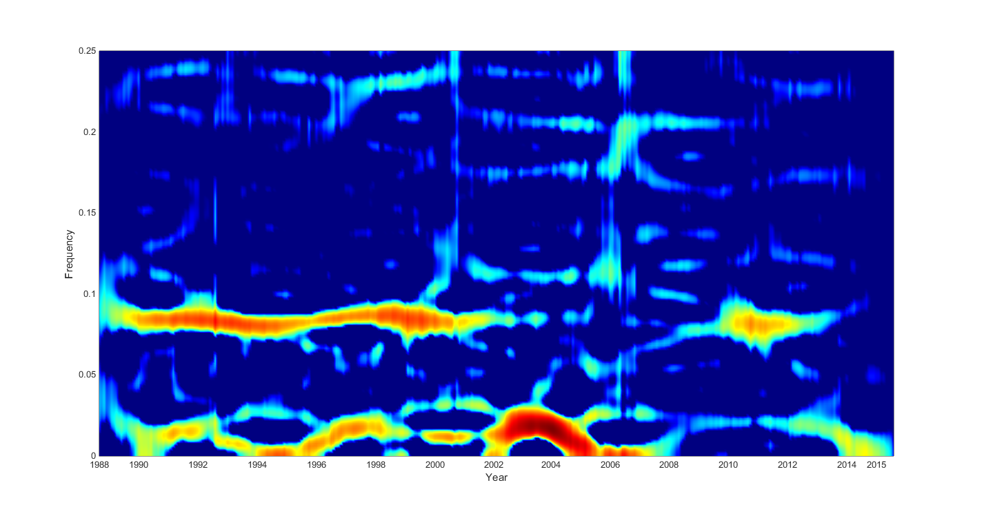
Zhao Atlas Marks Transform of the detrended gamma dose rate data. The Frequency is given in months⁻¹.The annual periodicity (frequency 0.083 months⁻¹) is not visible in the whole period (1988-2015). It is mainly visible from 1998-2002 and 2008-2014. On the contrary the 42 and 53 months periodicities (frequency about 0.02 months⁻¹) were very intense during the years 2002-2004 when the annual periodicity was weak.

Slide 14
…..Possible explanations
A 44 months periodicity identified by periodicity analysis of satellite global lower troposphere temperature data, 1979-2013, is in agreement with our 42.3±2.9 months periodicity. Troposphere is the most important for operational meteorology, as this layer contains almost all the water vapor, and by far the greatest part of the mass of the atmosphere.
Researchers of the Department of Meteorology and Climatology of the Aristotle University of Thessaloniki in Greece, performed spectral analysis of monthly surface temperature values from stations in Central and Eastern Mediterranean region for the 1950-1988 period. They found periodicities of 18, 36, 48, 54, 60 and 96 months. Out of these only the 48 and 54 months periodicities appear in the spectra of most stations

Slide 15
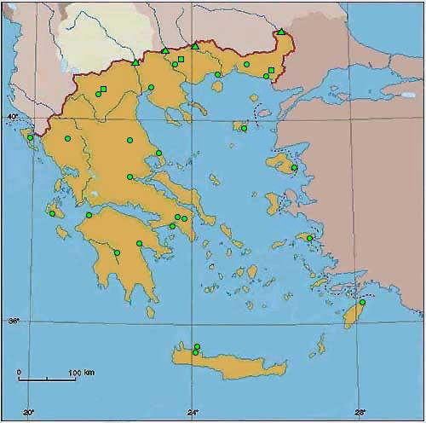
GREEK EARLY WARNING NETWORK (operated by the Greek Atomic Energy Commission)
In collaboration with GAEC , we performed the same work for the Thessaloniki station of the Greek early warning network based on Reuter Stokes ionization chambers
In comparison to NaI(Tl) detectors Reuter Stokes ionization chambers are sensible to cosmic radiation
Measurements are performed every 10 minutes (period 2001-2015)

Slide 16
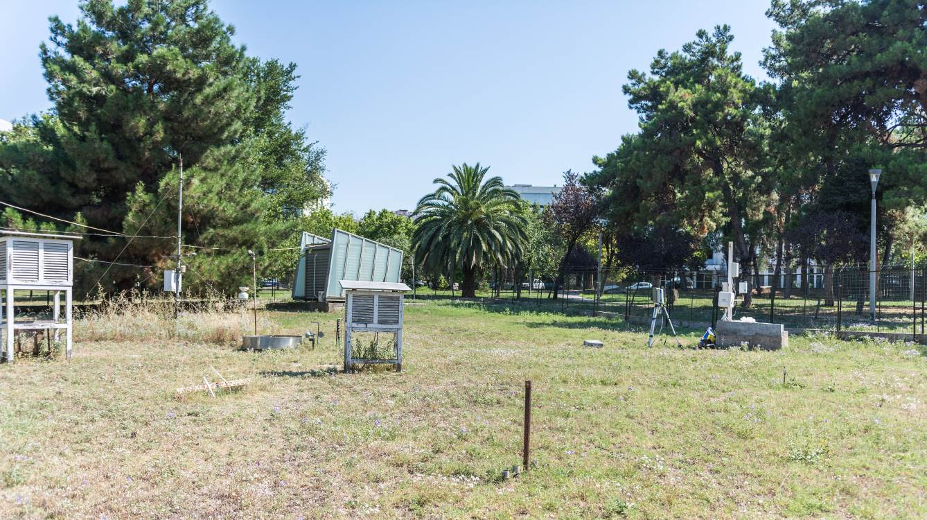
GREEK EARLY WARNING NETWORK (THESSALONIKI STATION-METEO)

Slide 17
FOURIER TRANSFORM
OUTSIDE THE NTL LAB (PerIod 2001-2015)
OUTSIDE THE NTL LAB (Total Period 1988-2015 )

Slide 18
FOURIER TRANSFORM METEO LOCATION (2001-2015)

Slide 19
No |  | NTL | magnitude | METEO | magnitude
1 | 12.2 months |  | 14.7 | 12.1 months | 72.27
2 | 13.7 months |  | 4.4 | 13.5 months | 5.1
3 | 18.3 months |  | 7 | 17.0 months | 2.65
4 | 21.3 months |  | 2.3 | 21.3 months | 3.73
5 | 25.6 months |  | 1.2 | 28.4 months | 8
7 | 42.6 months |  | 23.7 | 36.6 months | 6.5

Slide 20
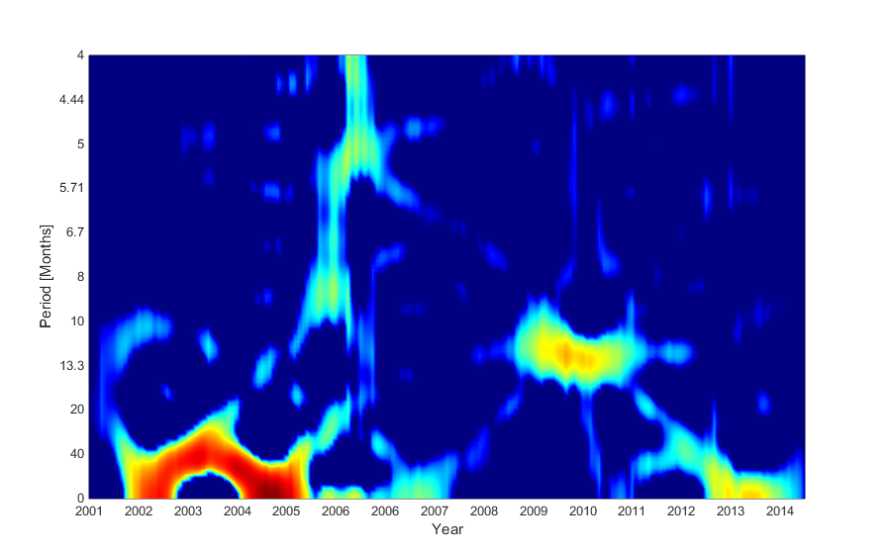
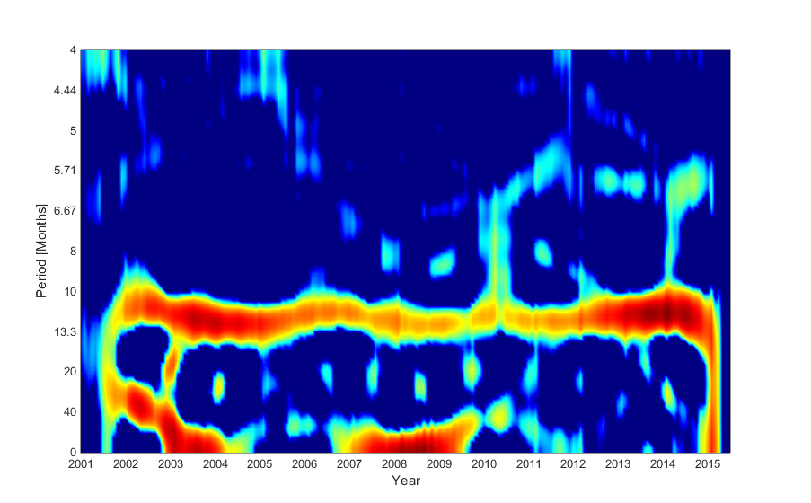
NTL LOCATION
METEO LOCATION

Slide 21
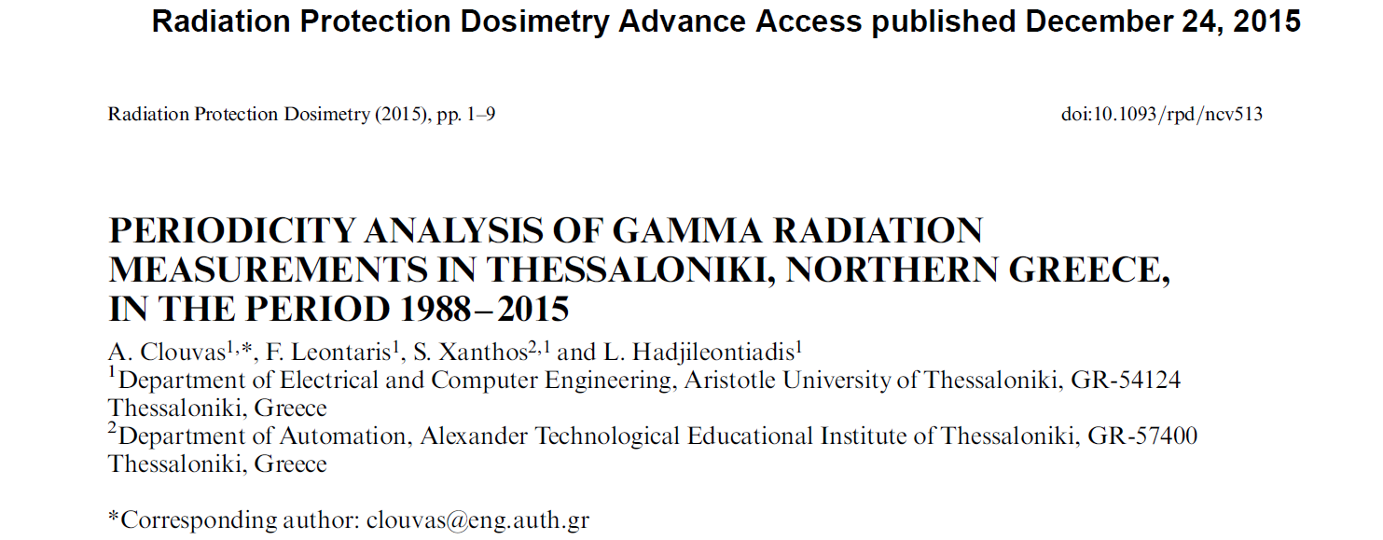
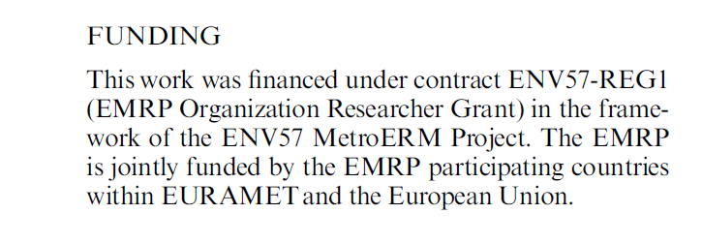
For more information…..

Slide 22
